Slide 1
MACHINE LEARNING

Slide 2
Topics TO COVER
Linear Regression
Logistic Regression
Decision Trees
Random Forests
Naive Bayes
Support Vector Machines
k-Nearest Neighbors
Clustering (K-means, Hierarchical clustering)
Principal Component Analysis (PCA)
Neural Networks (Feedforward, Convolutional, and Recurrent)

Slide 3
K-Means Algorithm
Customer segmentation:
Investment preferences
Behaviors
Characteristics
Investment strategies
Portfolio size
Trading frequency
Risk tolerance
K-means clustering is a commonly used unsupervised machine learning technique used for partitioning a given dataset into a predetermined number of clusters
The goal is to group similar data points together and minimize the distance between the data points within each cluster while maximizing the distance between different clusters.

Slide 4
How does K-MEANS Work?
Time complexity: O(n k T )
N – no.of data points
K – no.of clusters
T –no.of iterations
Randomly pick cluster centroids
Assign each data point to the closest centroid
Recompute the cluster centroid
Iterate the process for T steps

Slide 5
Named entity Recognition
NER model is pretrained using a process called "transfer learning.
Transfer learning involves using a pre-existing model that has been trained on a large dataset as a starting point for training a new model on a smaller, more specific dataset

Slide 6
HOW NER IS TRAINED?
Pre-train
The model is initialized with pre-trained word embeddings that have been trained on a large corpus of text data, such as GloVe or FastText
These embeddings represent the meanings of words in a high-dimensional vector space, which allows the model to capture semantic relationships between words.
Train
The model is trained on a labeled dataset of text data, such as news articles or scientific papers
This training process involves using a combination of supervised and unsupervised learning techniques to learn how to recognize these entities in new text data.
Fine-tune
the model can be fine-tuned on a smaller, more specific dataset to further improve its accuracy for a particular domain or application
The process of fine-tuning involves updating the model's internal parameters using a smaller labeled dataset of text data that is specific to the target domain
During training, the model updates its internal parameters to improve its ability to recognize named entities based on the patterns it learns from the labeled dataset

Slide 7
BAYES THEOREM
Mathematical formula used to determine the conditional probability of events
Essentially, the Bayes’ theorem describes the probability of an event based on prior knowledge of the conditions that might be relevant to the event.
Prior probability of an event with new evidence or information to obtain a posterior probability.

Slide 8
Bayes THEOREM
Credit Risk Analysis:
For example, a bank can use historical data on loan defaults to calculate the prior probability of a borrower defaulting on a loan.
As new information becomes available, such as changes in the borrower's credit score or financial statements, the bank can update its prior probability using Bayes' Theorem to obtain a more accurate estimate of the borrower's credit risk
This allows the bank to make better-informed decisions on loan approvals, interest rates, and collateral requirements.

Slide 9
Naïve BAYES THEOREM
Naive Bayes is a classification algorithm that works on the principle of Bayes' theorem, which describes the relationship between conditional probabilities of two events.
It assumes that the features of a dataset are conditionally independent given the class label, which means that each feature contributes equally to the classification outcome.
This assumption is often violated in real-world scenarios, but Naive Bayes still provides a fast and accurate way to classify data.

Slide 10
Gradient Boosting Trees
The algorithm starts with a single decision tree and uses it to make predictions. It then calculates the errors of the predictions and trains a new decision tree to correct those errors.
The new decision tree is trained on the residuals, which are the differences between the actual values and the predicted values of the previous tree. This process continues until the algorithm has created a set of decision trees, each correcting the errors of the previous one.
To combine the predictions of the individual trees, the algorithm takes a weighted average of their outputs, with the weights being determined by the performance of each tree on the training data.
Gradient Boosting is an ensemble learning technique that combines multiple weak learners to create a stronger model.

Slide 11
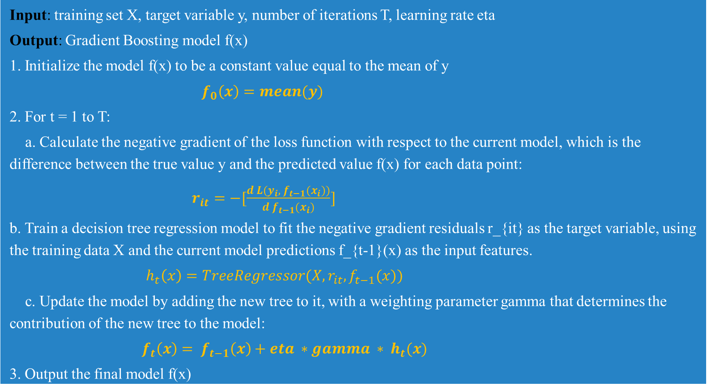
Gradient Boosting PseudoCode
Input: training set X, target variable y, number of iterations T, learning rate eta
Output: Gradient Boosting model f(x)
1. Initialize the model f(x) to be a constant value equal to the mean of y
$f_{0}\left(x\right)=mean(y)$
2. For t = 1 to T:
a. Calculate the negative gradient of the loss function with respect to the current model, which is the difference between the true value y and the predicted value f(x) for each data point:
$r_{it}=−[\frac{d L(y_{i}, f_{t−1}(x_{i}))}{d f_{t−1}(x_{i})}]$
b. Train a decision tree regression model to fit the negative gradient residuals r_{it} as the target variable, using the training data X and the current model predictions f_{t-1}(x) as the input features.
$h_{t}\left(x\right)=TreeRegressor(X, r_{it}, f_{t−1}(x))$
c. Update the model by adding the new tree to it, with a weighting parameter gamma that determines the contribution of the new tree to the model:
$f_{t}\left(x\right)= f_{t−1}\left(x\right)+eta ∗gamma ∗ h_{t}(x)$
3. Output the final model f(x)

Slide 12
Gradient Boosting for classification
Initialize model with frequent class as target variable
Calculate Negative gradient of loss function
Train decision tree to fit the residuals with X and preds as input
Output model
Update model with new tree with gamma parameter
Initialize the model as a constant value equal to the most frequent class in the target variable.
Calculate the negative gradient of the loss function with respect to the predicted probabilities for each data point.
Train a decision tree classifier to fit the negative gradient residuals as the target variable, using the training data and the current model predictions as the input features.
Update the model by adding the new tree to it, with a weighting parameter gamma that determines the contribution of the new tree to the model.

Slide 13
NEGATIVE GRADIENT OF LOSS FUNCTION
The negative gradient of the loss function is a measure of how much the current model's predictions differ from the true values. Specifically, it represents the direction and magnitude of the steepest descent of the loss function with respect to the predicted values.

Slide 14
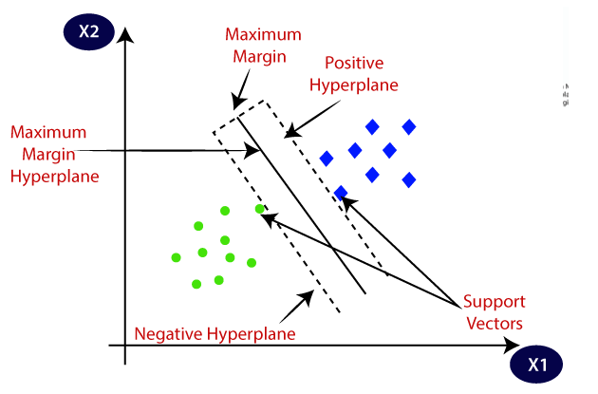
Support Vector Machine
Support Vector Machines are a popular machine learning algorithm used for both classification and regression tasks.
The main objective of SVM is to find the best possible decision boundary that separates data points belonging to different classes or to predicts continuous values.
In SVM, the decision boundary is represented by a hyperplane in a high-dimensional feature space. The algorithm aims to maximize the margin between this hyperplane and the support vectors, which are the data points closest to the decision boundary. The larger the margin, the better the generalization ability of the model.

Slide 15
Support Vector Machine: Key Ideas
Use optimization to find a hyperplane with few errors
Seek large margin separator in order to improve generalization of the model
Use kernel trick to make large feature spaces computationally efficient

Slide 16
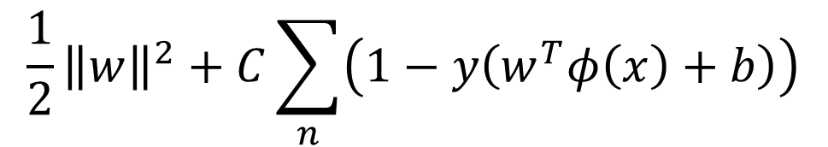
Support Vector Machine: Objective
The objective function of SVM, also known as the hinge loss, is used to train the model and find the optimal hyperplane.
The objective is to minimize the classification error and simultaneously maximize the margin. The hinge loss function penalizes misclassified samples, and the goal is to find the hyperplane that achieves the minimum hinge loss.
The objective function of SVM can be mathematically represented as:
minimize:
Parameter | Definition
||w|| | Norm of the weight vector
C | Regularization parameter that controls trade off between maximizing margin and minimizing the misclassification
y | Class label
x | Feature vector
b | Bias term
$$\frac{1}{2}{\left\|w\right\|}^{2}+C\sum_{n}{\left(1−y\left(w^{T}φ\left(x\right)+b\right)\right)}$$

Slide 17
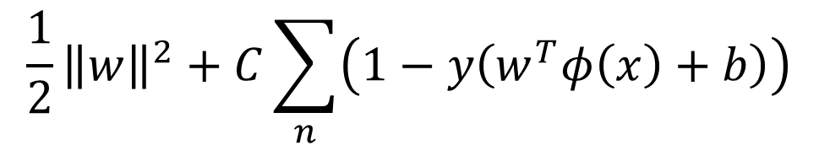
Support Vector Machine: Objective
minimize:
By solving the optimization problem, SVM finds the optimal values for the weight vector w and the bias term b, which define the decision boundary that maximizes the margin and minimizes the misclassification.
$$\frac{1}{2}{\left\|w\right\|}^{2}+C\sum_{n}{\left(1−y\left(w^{T}φ\left(x\right)+b\right)\right)}$$
1/2 * ||w||^2 represents the regularization term that encourages a smaller weight vector to prevent overfitting.
The second term Σ(max(0, 1 - y_i * (w^T * x_i + b))) calculates the hinge loss, penalizing misclassified samples based on their distance from the decision boundary.

Slide 18
Support Vector Machine: Kernel
The kernel function in Support Vector Machines (SVMs) plays a crucial role in enabling SVMs to efficiently handle complex, nonlinear patterns in the data by implicitly mapping the input data into a higher-dimensional feature space, where the data points may become linearly separable.
Mathematically, given two input data points x and y, the kernel function k(x, y) computes the dot product of their transformed feature vectors in the higher-dimensional space:
k(x, y) = φ(x) ⋅ φ(y)
Where φ(⋅) denotes the mapping function that maps the input data into the higher-dimensional feature space
The basic idea behind the kernel function is to compute the similarity between pairs of data points without explicitly calculating the coordinates of the points in the higher-dimensional feature space
Now, this implies calculates the dot product (similarity) between the transformed feature vectors.

Slide 19
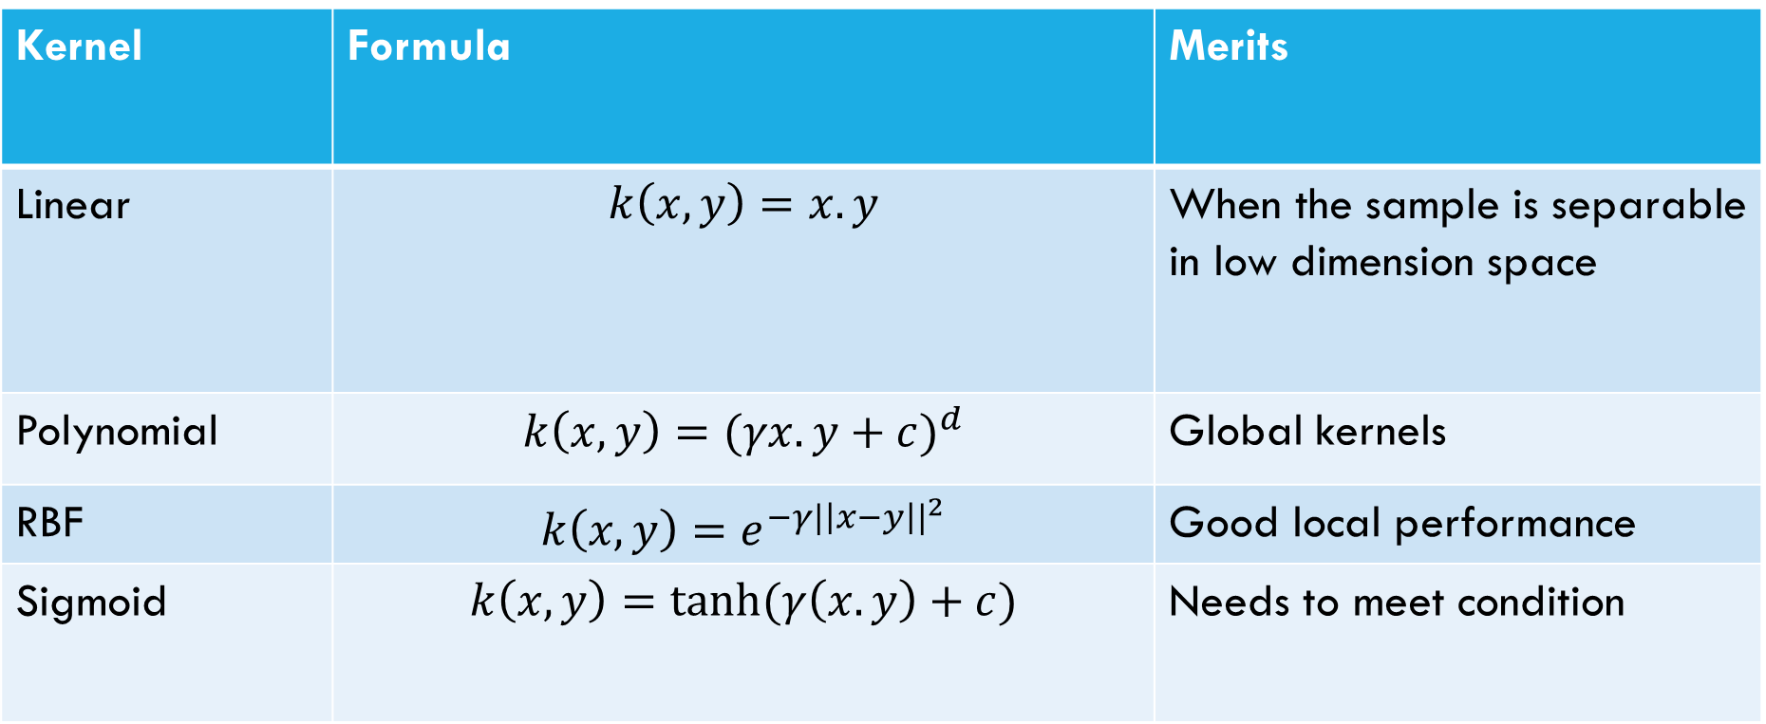
Support Vector Machine: Kernel
Kernel | Formula | Merits
Linear | $$k\left(x, y\right)=x.y$$ | When the sample is separable in low dimension space
Polynomial | $$k\left(x,y\right)={(γx.y+c)}^{d}$$ | Global kernels
RBF | $$k\left(x,y\right)=e^{{−γ|\left|x−y\right||}^{2}}$$ | Good local performance
Sigmoid | $$k\left(x, y\right)=\tanh{(γ\left(x.y\right)+c)}$$ | Needs to meet condition

Slide 20
1
2
3
4
5
SVM identifies the hyperplane that best separates the data points into different classes
The hyperplane is defined as the decision boundary between the classes, with the maximum margin between the closest data points from each class
SVM maps the input data into a high-dimensional feature space, where it becomes easier to separate the classes by a hyperplane
The hyperplane is determined by finding the optimal separating boundary, which is the one that minimizes the classification error and maximizes the margin between the two classes.
The optimal hyperplane is found by solving an optimization problem that involves maximizing the margin subject to the constraint that all data points are correctly classified.

Slide 21
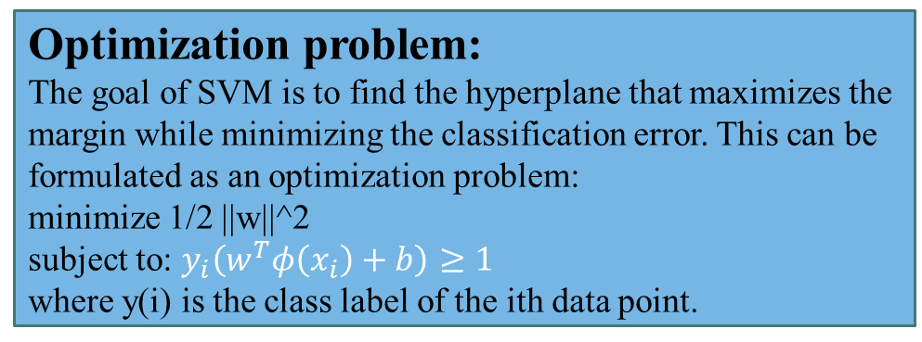
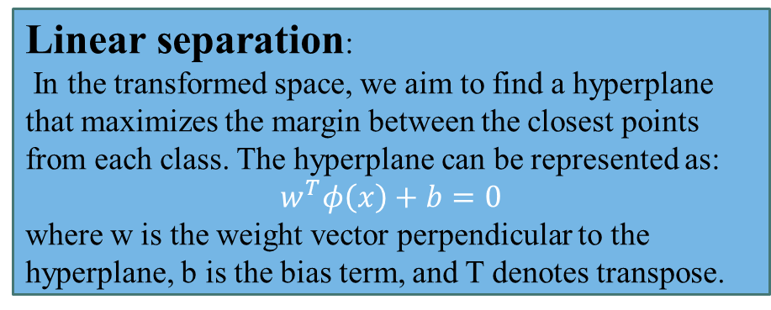
Data transformation:
In order to separate non-linearly separable data, we transform the input data into a higher-dimensional space using a non-linear mapping function, denoted by Φ(x). The transformed data points can be represented as:
Φ(x) = [Φ(x1), Φ(x2), ..., Φ(xn)]
Optimization problem:
The goal of SVM is to find the hyperplane that maximizes the margin while minimizing the classification error. This can be formulated as an optimization problem:
minimize 1/2 ||w||^2
subject to: $y_{i}\left(w^{T}φ\left(x_{i}\right)+b\right)≥1$
where y(i) is the class label of the ith data point.
Linear separation:
In the transformed space, we aim to find a hyperplane that maximizes the margin between the closest points from each class. The hyperplane can be represented as:
$$w^{T}φ\left(x\right)+b=0$$
where w is the weight vector perpendicular to the hyperplane, b is the bias term, and T denotes transpose.
Lagrange multiplier:
The optimization problem can be solved using the Lagrange multiplier method, where we introduce Lagrange multipliers αi to enforce the constraints in the optimization problem. The dual problem can be written as:
maximize Σi αi - 1/2 Σi,j αi αj y(i) y(j) Φ(x(i))T Φ(x(j))
subject to: Σi αi y(i) = 0, αi >= 0
Margin calculation:
The margin is the distance between the hyperplane and the closest data points from each class. The margin can be calculated as:
margin = 2 / ||w||
Kernel function:
The inner product Φ(x(i))T Φ(x(j)) can be computationally expensive to calculate for high-dimensional data. Therefore, we use a kernel function K(x(i), x(j)) that computes the inner product in the transformed space without explicitly transforming the data. Popular kernel functions include the linear kernel, polynomial kernel, radial basis function (RBF) kernel, and sigmoid kernel.

Slide 22
Continuous Bag of Words
The continuous bag of words (CBOW) model is a type of neural network language model used in natural language processing (NLP).
The CBOW model is used to predict the target word based on the context words that surround it.
The objective of the CBOW model is to minimize the negative log-likelihood of the target word given the context words.
The model is trained using backpropagation and stochastic gradient descent.

Slide 23
Continuous Bag of Words
The model takes a sequence of context words as input.
Each context word is converted into a one-hot vector.
The one-hot vectors are averaged to form a context vector.
The context vector is passed through a hidden layer.
The output layer of the model predicts the target word.

Slide 24
Skip Grams
Input data
The skip-gram model takes a large corpus of text as input and creates a vocabulary from it.
Each word in the vocabulary is represented as a one-hot vector
Word embeddings
The skip-gram model creates word embeddings by mapping each one-hot vector to a lower-dimensional vector of real numbers. This is done using a neural network with a hidden layer.
Training
The skip-gram model is trained to predict the context words that surround a given target word
The context words are determined by a sliding window of fixed size that moves over the text.
Output Layer
The output layer of the skip-gram model is a softmax function that computes the probability of each word in the vocabulary being a context word given the target word.
Loss function
The loss function used to train the skip-gram model is the negative log-likelihood of the target word given the context words.
Optimization
The skip-gram model is optimized using stochastic gradient descent. During training, the weights of the neural network are updated iteratively to minimize the loss function

Slide 25
Self Attention
Dot-product attention
We then compute the attention scores between each pair of query and key vectors using dot-product similarity. The dot product between the query and key vectors for a given pair of words represents their similarity, and is used to compute an attention weight. We apply a softmax function to the attention scores to obtain a probability distribution over the values. These attention weights capture how much each word in the input sequence contributes to the representation of each other word
Input embeddings
We first embed each word in the input sequence into a d-dimensional vector space using a learned embedding matrix. The resulting input embeddings are [e1, e2, e3], where each ei is a d-dimensional vector.
Query, key, and value vectors
Weighted sum of values
Next, we compute query, key, and value vectors for each word in the input sequence. These are learned weight vectors of dimensionality d, which are used to compute attention weights between words. For example, the query vector for the first word "The" might be [q1, q2, ..., qd]
We finally compute a weighted sum of the value vectors for each word in the input sequence, using the attention weights as weights. This produces a new representation of each word in the input sequence, which captures its relationship to the other words. This process is repeated multiple times to iteratively refine the representations of each word.

